Slide 1
Succession Planning
State & Territory AT Leadership Symposium
March 4-6, 2020
Renaissance Downtown, Washington, D.C.

Slide 2
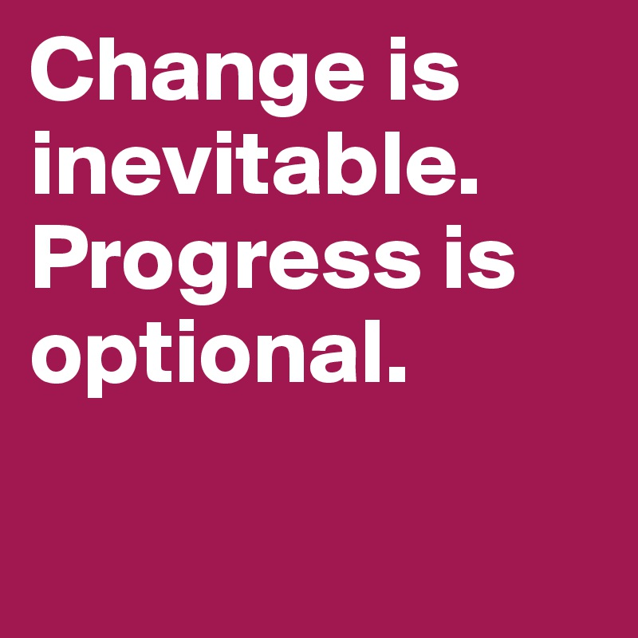
Succession planning or…how do you eat an elephant?

Slide 3
Session Focus
Presenters will discuss:
How have different programs approached succession planning and staff turnover?
What are some key areas of knowledge for new directors and staff?
What are key practice/activity areas in which potential future directors should be familiar?

Slide 4
Presenters
Dave Scherer, AT3 Center (former South Dakota Director)
David.scherer@ataporg.org
Page Hudson, South Dakota
phudson@dakotalink.net
Angela Standridge, Texas
astandridge@Austin.utexas.edu
Yakima Black, Louisiana
yblack@latan.org
David Baker, Missouri
dbaker@mo-at.org

Slide 5
How does your program structure matter?
State agencies, Universities, and Nonprofits.
Who determines your hiring parameters?
Which parts of your services are centralized and which are operated through contracts?
What kind of role does your advisory council play?

Slide 6
DakotaLink – South Dakota
David Scherer, AT3 Center
Page Hudson, DakotaLink

Slide 7
South Dakota
Lead Agency – Vocational Rehabilitation
Implementing Agency – Education Coop (Quasi-governmental)
A rural state with a population 870,000, South Dakota is the 5th least densely populated state.
Long term director transitioning to long-term staff member.

Slide 8
Texas Technology Access Program
Angela Standridge

Slide 9
Texas – New director from outside the organization.
Implementing Agency - University Center of Excellence in Developmental Disabilities (UCEDD) at University of Texas.
Second largest population in the U.S. – 27 million + and second largest geographically.
A new director - very good AT background but entering a completely new system. Lots of on-the-job learning.

Slide 10
Louisiana Assistive Technology Access Network
Yakima Black

Slide 11
Louisiana Assistive Technology Network
Lead Agency – LA Department of Health and Hospitals
Implementing Agency – Nonprofit
Middle of the pack in state population and state size.
Transitioning from a long-term director – over 20 years.
Had gone through transition from Developmental Disabilities to a Nonprofit years ago.

Slide 12
Missouri Assistive Technology
David Baker

Slide 13
Missouri Assistive Technology
State Agency – Education
Many years of experience with AT; long tenure with MoAT.
Dealing with staff turnover since becoming director.

Slide 14
Staff Recruitment and Building Competencies
What did those open positions entail?
Recruiting
Experience with AT?
Need to have or acquire certification like ATP?
Specialization vs. Generalist
How do you increase competencies for your staff (on a limited budget!)

Slide 15
Director Succession Top 10 (or 20 or 30)
1. Introductions to program contacts and relationships in your state.
History of your state AT program and of the AT Act.
ATAP and AT3 Resources
Administration
Acronyms and Laws
Annual AT Administrative Calendar – receive and process your award; annual progress report, state plan.
5. Budget and Subcontracting Processes.

Slide 16
Director Succession Top 10 (continued)
Managing and Leveraging Resources
Scan state level activities – demonstration, device loan, reuse, state finance
Scan state leadership activities – public awareness, training, technical assistance, I&R
Scan your current staff and future needs.
Using your Advisory Council.

Slide 17
AT Roadmap for New Directors
AT3 Center Roadmap for New Directors
https://www.at3center.net/repository/roadmap
Introduction Who's Who The Assistive Technology Act of 2004 Required Activities Program Administration Fiscal Management Communication

Slide 18
Questions, Suggestions, Requests?
Thank you panelists and participants!

