Slide 1
Unpacking Federal Funding Streams
. . . to identify state level opportunities for collaboration and leveraged funding

Slide 2
Major AT Related State Grant Funding Systems
IDEA, VR and Medicaid
Unpacking Questions:
What is the core purpose of the funding?
How can/must funds be spent? Anything specific to AT?
How is stakeholder input solicited/used for allocation decisions?
What level of funding is available in my state/territory?
How does my state/territory allocate their award amount?
Are there opportunities for collaboration?

Slide 3
Individuals with Disabilities Education Act IDEA Basics
Part B - special education for children with disabilities age 3-21
Section 611 – core grant ages 3-21
Section 619 – additional grant ages 3 through 5
Part C - early intervention for children with disabilities age birth to 3
Part B (Section 611) grants to states funding allocation ≈ 12 billion
All AT Program grantee states and territories get a Part B formula allocation
Range from ≈ 5 million in CNMI to over 1 billion in CA and TX
https://www2.ed.gov/fund/data/award/idea/index.html
https://www2.ed.gov/about/overview/budget/statetables/index.html

Slide 4
IDEA Part B- Section 619 Funding Allocation Requirements
Most (about 90%) flows through to local districts per formula
Remainder can be used for administrative expenses and authorized state-level discretionary activities
20 U.S. Code § 1411 (e) State-level activities (2)(C) Authorized activities
(iv) To improve the use of technology in the classroom by children with disabilities to enhance learning.
(v) To support the use of technology, including technology with universal design principles and assistive technology devices, to maximize accessibility to the general education curriculum for children with disabilities.

Slide 5
IDEA Part B Annual Application with Funding Allocations
ED Form 9055 Annual IDEA Part B Application – locate online or request
OSEP provides an interactive excel spreadsheet with overall administrative and discretionary allocation identified to each State Education Agency (SEA)
SEA allocates discretionary funding to authorized activities
Two mandatory activities (minimum of 1 dollar each)
monitoring, enforcement and compliant investigation and
establishing and implementing a mediation process.
List of optional activities any available amount allowed – two AT related
SEA must describe the process used to get input regarding the distribution of amounts among the above discretionary activities (usually through advisory groups and organizations).

Slide 6
IDEA Part B Discretionary Funding Examples
State | Classroom Technology | AT & UD Tech for Curriculum Access
AK | $200,000 | $336,163
DE | $200,000 | $230,000
FL | $944,000 | $944,070
IN | 0 | $3,150,000
MN | $185,000 | $275,000
MO | 0 | $500,000
NE | 0 | $700,000
PA | $2,561,686 | $567,597
VA | $127,772 | $947,028
WV | $100,00 | $200,000

Slide 7
Vocational Rehabilitation State Grants
to provide services to individuals with disabilities so they may prepare for and engage in competitive integrated employment. Administered through the Rehabilitation Services Administration (RSA).
For FFY17, a total of $3,121,050,774 was distributed to states and territories.
In 24 states and territories, awards are made to both the VR state agency for the blind and to the general VR agency. In 32 states, awards are made to a combined agency only.

Slide 8
How can/must funds be spent?
Funds to states are distributed on a statutory formula and states must provide a portion of the funds. The federal share is 78.7%; the state share is 21.3%.
(34 CFR §361.60).
Under WIOA, state VR agencies may provide services not only for individuals, but also for groups of individuals including AT loan, demonstration, reutilization or financing programs in coordination with the State AT Program.

Slide 9
Anything specific to AT?
Rehabilitation Technology, which includes assistive technology devices and services must be provided to individuals when needed to reach employment goals.
Some states, in their annual rehabilitation council reports, report on the numbers, cost and types of rehabilitation technology including assistive technology provided during the year, as well as collaboration with the State AT Program (e.g. Missouri).

Slide 10
How is stakeholder input solicited/used for allocation decisions?
States must submit a Unified or Combined State Plan. The Workforce Innovation and Opportunity Act (WIOA) requires that the VR state plan must describe their cooperation with State AT Programs.

Slide 11
Vocational Rehabilitation Funding
What level of funding is available in my state/territory?
RSA has awards for each state and territory listed on-line at:
https://rsa.ed.gov/programs.cfm?pc=basic-vr&sub=awards
How does my state/territory allocate their award amount?
Under WIOA, a state must reserve at least 15% of its state allotment for the provision of pre-employment transition services to students with disabilities.
Order of Selection process – when funding isn’t sufficient, serving individuals with the most significant disabilities first.

Slide 12
Are there opportunities for collaboration?
WIOA requirements include:
State VR agencies must have developed working relationships and enter into agreements with State AT Programs for the coordination of activities.
State VR agencies must include, as part of their staff development, training in coordination with State AT Programs.

Slide 13
Medicaid Basics
Title XIX of the Social Security Act of 1965
Administered by the Centers for Medicare and Medicaid
Mandatory and Optional Medicaid Services:
https://www.medicaid.gov/medicaid/benefits/list-of-benefits/index.html

Slide 14
Services - Medicaid State Plans
Medicaid State Plan amendments for each state:
https://www.medicaid.gov/state-resource-center/medicaid-state-plan-amendments/index.html
42 C.F.R. Part 440, Subpart A - Federal definitions of mandatory and optional benefits, see
42 C.F.R. 440.70(3)(ii) Home Health Services

Slide 15
Funding Allocation Requirements
Most (about 96%) account for direct services.
Federal Medical Assistance Match Rates (FMAP)
Based on state’s average personal income. Ranges from a floor of 50% to a high of approximately 74%
Remainder can be used for administrative expenses and authorized state-level discretionary activities

Slide 16
Medicaid Administrative Claiming
About 4% of Medicaid funding is spent on administrative functions, under a program called “Medicaid Administrative Claiming”.
to cover activities that contribute to the efficient and effective administration of the Medicaid program
Any public agency can claim Medicaid Administrative Claiming. Most often it is claimed by schools, social service, and mental health agencies.
42 CFR § 433.15 - Rates of Federal Financial Participation for administration.

Slide 17
Examples of Administrative Activities Reimbursed
Case Management
Outreach and enrollment
Planning and development
Training
Reporting/program management
Network development
Quality improvement
Opportunities for Collaboration?

Slide 18
State Strategies to Promote the Use of Technology in HCBS Policies and Funding Considerations
National Association of State
Directors of Developmental Disabilities Services (NASDDDS)
NASDDDS
National Association of State Directors of Developmental Disabilities Services

Slide 19
NASDDDS
The National Association of State Directors of Developmental Disabilities Services (NASDDDS) represents the nation's developmental disability agencies in 50 states and the District of Columbia providing services and supports to children and adults with intellectual and developmental disabilities and their families.
The NASDDDS mission is to assist member state agencies in building person-centered systems of services and supports for people with intellectual and developmental disabilities and their families
NASDDDS
National Association of State Directors of Developmental Disabilities Services

Slide 20
NASDDDS Goal and Mission
To promote and assist state agencies in developing effective, efficient service delivery systems that furnish high-quality supports to people with intellectual and developmental disabilities by providing:
timely analyses of federal statutory and regulatory policies that affect people with disabilities,
disseminate cutting edge information on state-of-the-art programs and service delivery practices,
provide technical assistance and support to member states,
offer a forum for the development of state and national policy initiatives.
NASDDDS
National Association of State Directors of Developmental Disabilities Services

Slide 21
NASDDDS Core Projects
National Core Indicators-Joint venture between NASDDDS and Human Services Research Institute (HSRI). Gather standard set of performance and outcome measures that can be used to track state’s performance over time, compare results across states, and establish national benchmark
State Employment Leadership Network-Partnership of NASDDDS and Institute of Community Inclusion, University of Massachusetts Boston (ICI)
Provides technical assistance and guidance to state I/DD agencies to develop more effective employment systems.
States can connect, collaborate, problem solve and share resources that address the pressing employment-related issues that states face
NASDDDS
National Association of State Directors of Developmental Disabilities Services

Slide 22
NASDDDS Core Projects
Technical Assistance
NASDDDS provides technical assistance throughout the country on an array of issues surrounding services and supports for individuals with I/DD. Many of NASDDDS’ engagements with states surround Medicaid coverage for a host of different services and service modalities – Technology is emerging a critical interest area in State TA needs.
NASDDDS
National Association of State Directors of Developmental Disabilities Services
Notes:
Original CoP consisted of 5 states and 1 mentor state. In 2016 expanded 11 more states for a total of 17 state teams

Slide 23
NASDDDS Core Projects
Community of Practice for Supporting Families Across the LifeSpan-Goal
To build capacity through a community of practice across and within States to create policies, practices and systems to better assist and support families than include a member with I/DD across the lifespan. Enhanced national and state policies, practices, and sustainable systems that result in improved supports to families. Partnership between NASDDDS and UMKC, Kansas City.
Each of NASDDDS Core Projects has a Technology Focus!
NASDDDS
National Association of State Directors of Developmental Disabilities Services
Notes:
Original CoP consisted of 5 states and 1 mentor state. In 2016 expanded 11 more states for a total of 17 state teams

Slide 24
Charting the LifeCourse, CoP for Supporting Families- Integrated Supports STAR-NASDDDS and UMKC working with States to Include Technology
https://www.lifecoursetools.com/
NASDDDS
National Association of State Directors of Developmental Disabilities Services
Notes:
MAPPING
PROBLEM SOLVING
PLANNING LTSS
PLANNING ACTIVITIES
We ALL do this without even thinking about it

Slide 25
Technology Landscape: Medicaid
Coverage for Assistive Technology – HCBS and State Plan Benefits (1915(c), 1915(i), Home Health Benefit, others)
Information Technology Advancements – Business Support (HITECH, MITA)
Emphasis on Tools for Care Coordination – Improving information-sharing to achieve integration
NASDDDS
National Association of State Directors of Developmental Disabilities Services
Notes:
Original CoP consisted of 5 states and 1 mentor state. In 2016 expanded 11 more states for a total of 17 state teams

Slide 26
2018 Technology Solutions State Survey
NASDDDS
National Association of State Directors of Developmental Disabilities Services
Notes:
May of 2018 partnered with NASDDDS to do an in-depth evaluation of the states.

Slide 27
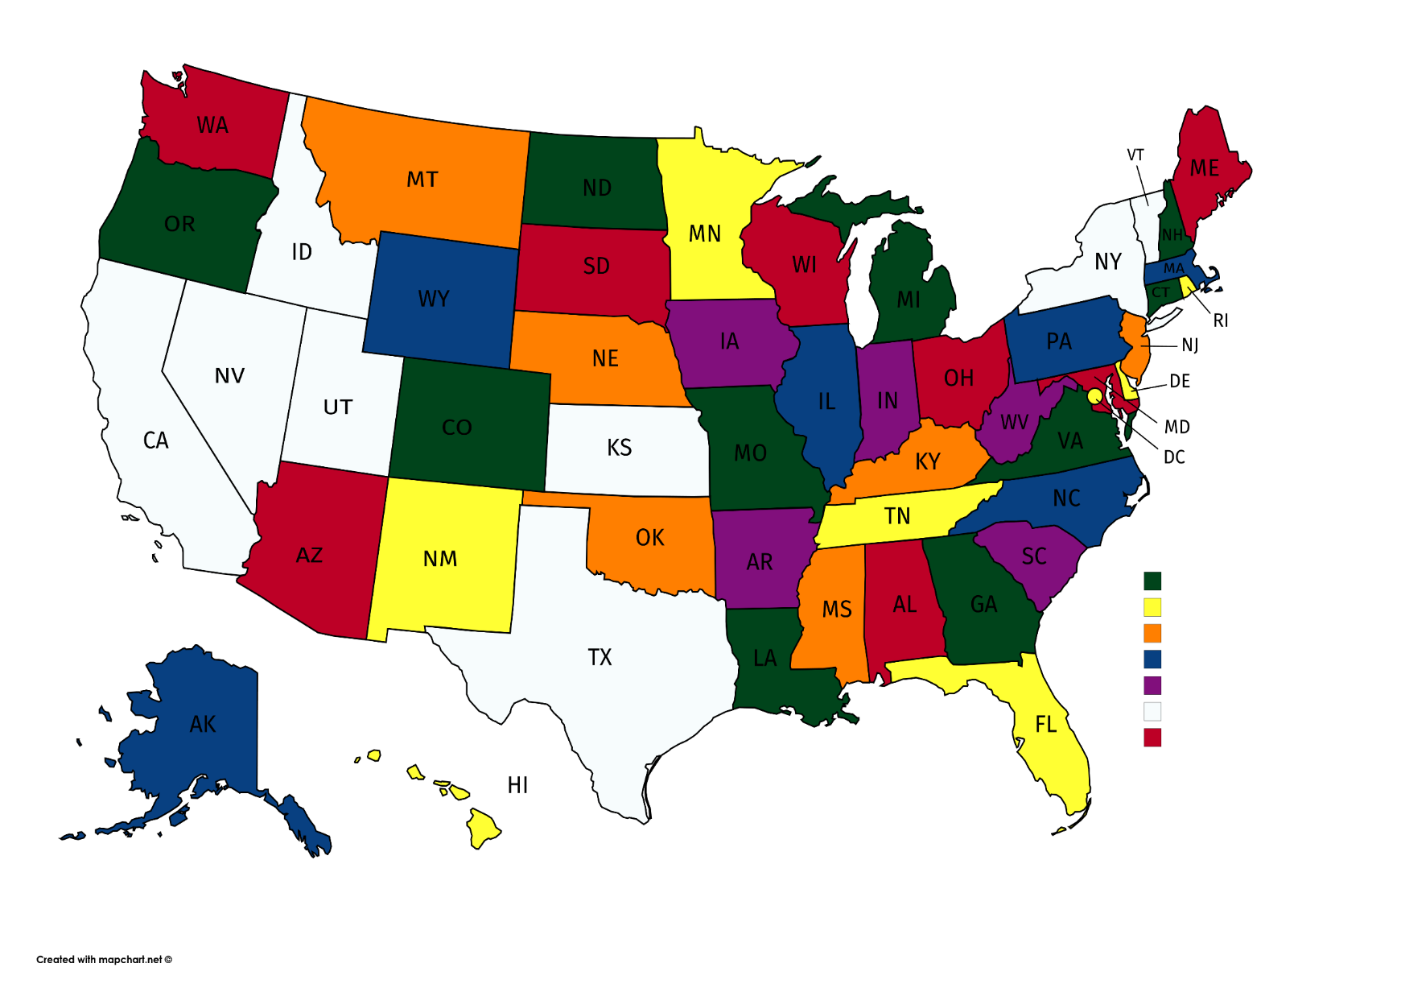
Technology Solutions State Survey
Purpose: To investigate creative funding mechanisms and interest in technology solutions for people with IDD across the U.S.
42 States and District of Columbia Responded
NASDDDS
National Association of State Directors of Developmental Disabilities Services

Slide 28
What Technology Services and Supports Does Your State Currently Fund?
NASDDDS
National Association of State Directors of Developmental Disabilities Services
Notes:
Categories identified from HCBS waiver categories and other sources of interest.

Slide 29
Are Smart Home Technologies Included in Environmental Accessibility Adaptations (EAA), Environmental Controls or Home Modifications?
60% No
30% Yes
9% Not Applicable
NASDDDS
National Association of State Directors of Developmental Disabilities Services
Notes:
Smart Home technology products comprised of sensors, microprocessors, data storage, controls, software and typically, an embedded operating system and enhanced user interface and capability of running autonomously. Also most smart products perform multiple tasks.
Nano Leaf remote – works with apple home HomeKit

Slide 30
Application of Remote Teleservices in States
NASDDDS
National Association of State Directors of Developmental Disabilities Services
Notes:
Remote monitoring is used as a tool by 21 states for supported living
5 for Supported/Integrated Employment

Slide 31
Federal Funds are Utilized to Purchase Technology Services, Applications, Devices or Other Technology Solutions
NASDDDS
National Association of State Directors of Developmental Disabilities Services
Notes:
Other Sources Include:
Local County Board Resources
DDS Family Grants
Tech 4 Home and Innovation Grants
1915 (i) HCBS SPA
Community First Choice 1915 (k)
1915 (J) Waiver
University Provided Technology
PASRR State Plan

Slide 32
Does Your State Provide Funding for Ongoing Technology Training to Learn, Upkeep and Update Purchased Technology?
NASDDDS
National Association of State Directors of Developmental Disabilities Services
Notes:
Two of the greatest barriers to technology use as you have seen from the Ohio study are
Lack of training
Inability to solve problems with technology when they occur
Needs to be a holistic approach to technology. It is not enough to simple purchase hardware, software and systems you need to teach people to use it.

Slide 33
Federal Funds are Utilized to Provide Ongoing Technology Training to Learn, Upkeep, and Update Purchased Technology
NASDDDS
National Association of State Directors of Developmental Disabilities Services

Slide 34
Services Purchased with Public Dollars, Pilots or Special Programs
NASDDDS
National Association of State Directors of Developmental Disabilities Services
Notes:
11 States do not fund any of the following categories
54% of adults living with a disability use the Internet compared with 81% of adults without a disability (Fox& Boyles, 2012)
More than 50% of youth with disabilities (ages 15-24) report the do not have all the assistive devices they need
25% do not have any devices (Lindsay & Tsybina, 2011)
Technology Divide is still prevalent
Home computer, Internet and Broadband Adoption:
53% of those with a disability had a computer as compared to 79% of the general population
48% of those with a disability used the internet as compared to 76% of the general population
46% of those with a disability had adopted broadband compared to 73% of the general population
National Telecommunications and Information Administration and Economics and Statistics Administration in the U.S. Department of Commerce

Slide 35
State Adoption of Electronic Documentation Systems
Billing (23 states)
Plan of Care / ISP Record (20 states)
Updating ISP Documentation (18 states)
Staff Management (5 states)
NASDDDS
National Association of State Directors of Developmental Disabilities Services
Notes:
Random list of companies – no one consistent leader

Slide 36
Is the Consideration of Technology Supports and Services a Requirement Within the ISP or Person-Centered Plan?
States That Require Technology Supports As Part Of ISP Or Person-centered Plan
Arizona | Nebraska
Colorado | New Hampshire
Connecticut | New Mexico
District of Columbia | North Dakota
Iowa | Ohio
Maryland | Oregon
Massachusetts | South Carolina
Michigan | Virginia
Minnesota | Washington
Mississippi | West Virginia
NASDDDS
National Association of State Directors of Developmental Disabilities Services

Slide 37
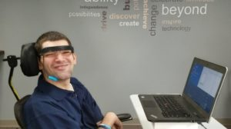
How do Families Discover Technology Solutions?
Assistive Technology Act Programs
Case Managers and Providers
Vocational Rehabilitation
Universities
Medical and Educational Professionals
Online
NASDDDS
National Association of State Directors of Developmental Disabilities Services
Notes:
“…our society has not evolved to the point where this population uses technology to the extent needed to enjoy the rights of full citizenship, as recognized by the Constitution.” (2016)
National Council on Disability Report

Slide 38
What Emerging Technologies Are States Interested In?
Smart Homes
Health Related Technologies (sensors, telehealth, etc.)
Remote Monitoring
Transportation Technologies
Mainstream Technologies
NASDDDS
National Association of State Directors of Developmental Disabilities Services
Notes:
No real consistent answer
Kyle noted high prevalence of falls – did you know there is technology that integrates there are sensors into clothing that can identify when a fall occurs, the directionality of the fall, alert caregivers when a fall happens and even in some cases deploy air bags
Other areas: Companion care, employment and a variety of Service supports (staff supports, case management, electronic visitation verification, assessment, payment options)

Slide 39
NASDDDS-Technology Considerations Seeing More Telehealth Focused on HCBS
Seeing More Telehealth Focused on HCBS
Nebraska for Consultation in behavior support, “ to improve the independence and inclusion of participants in their community.” It is in the community where people live, with their team and more a part of natural life.
New York has telehealth in HCBS as do more states, increasing over time.
NASDDDS
National Association of State Directors of Developmental Disabilities Services
Notes:
The purpose of providing Assistive Technology through our HCBS Waivers is to increase, maintain, or improve functional capabilities of waiver participants.
It is currently available on two of our five waiver programs including Individual and Family Services (IFS) and Children’s Intensive In-Home Behavioral Supports (CIIBS) Waivers.
Funding is limited to $1,200-$3,600/year for any combination of services on the IFS waiver and $4,000/month for any combination of services on the CIIBS waiver.
Similar to CFC, the equipment must be recommended by a qualified professional.
Waiver is the payer of last resort and assistive technology needs can often be met through CFC; this may help to explain the limited scope of diversity in assistive technology purchases on the waiver.
Also similar to CFC, waiver expenditures increased by over 500% from 2016 to 2017. The large increase can be attributed to trainings, technology demonstrations, increased awareness, and increased accessibility to these technologies.

Slide 40
NASDDDS-Technology Considerations Interested in Technology beyond Remote Monitoring
Remote monitoring is important but exploring more ways to fund and support different technologies:
Example: Washington Community First Choice offers $500 annually for iPads, apps, automatic shut-off stoves, one touch push buttons, bidets, medication reminder systems. Increase independence and decrease reliance on personal care services
Washington also has two waivers with flexible tech:
switches, smart watches, adaptive equipment, communication
And we are seeing more smart home and employment support technologies funded nationally.
NASDDDS
National Association of State Directors of Developmental Disabilities Services
Notes:
The purpose of providing Assistive Technology through our HCBS Waivers is to increase, maintain, or improve functional capabilities of waiver participants.
It is currently available on two of our five waiver programs including Individual and Family Services (IFS) and Children’s Intensive In-Home Behavioral Supports (CIIBS) Waivers.
Funding is limited to $1,200-$3,600/year for any combination of services on the IFS waiver and $4,000/month for any combination of services on the CIIBS waiver.
Similar to CFC, the equipment must be recommended by a qualified professional.
Waiver is the payer of last resort and assistive technology needs can often be met through CFC; this may help to explain the limited scope of diversity in assistive technology purchases on the waiver.
Also similar to CFC, waiver expenditures increased by over 500% from 2016 to 2017. The large increase can be attributed to trainings, technology demonstrations, increased awareness, and increased accessibility to these technologies.
All three Ohio DD waivers permit: (1) remote support equipment and (2) remote support services.
•Since 2011.
Flood Sensors
–Bed sensors
–Door and window sensors
–Motion detectors
–Fall deterctors
–Medication dispensers
–etc.
Sometimes necessary.
–Cameras are rarely used in private areas. More likely used in common areas: living room, kitchen, doorway.
–Only used when determined least intrusive solution
How many people (… of 37,000) do you think use remote support 281

Slide 41
NASDDDS-Technology Considerations Interested in Technology Beyond Remote Monitoring
We are seeing iPads, apps, Alexis, Ring and other technology that all people use. Challenges remain-will the waiver or other Medicaid authorities always cover if the device is used for purpose beyond work and community living? Becoming more flexible.
How do we learn about advances with open minds-Google cars, AI, and emerging technology? Is it something that can be covered? Offered equitably? Where to take the first steps.
NASDDDS
National Association of State Directors of Developmental Disabilities Services
41
Notes:
The purpose of providing Assistive Technology through our HCBS Waivers is to increase, maintain, or improve functional capabilities of waiver participants.
It is currently available on two of our five waiver programs including Individual and Family Services (IFS) and Children’s Intensive In-Home Behavioral Supports (CIIBS) Waivers.
Funding is limited to $1,200-$3,600/year for any combination of services on the IFS waiver and $4,000/month for any combination of services on the CIIBS waiver.
Similar to CFC, the equipment must be recommended by a qualified professional.
Waiver is the payer of last resort and assistive technology needs can often be met through CFC; this may help to explain the limited scope of diversity in assistive technology purchases on the waiver.
Also similar to CFC, waiver expenditures increased by over 500% from 2016 to 2017. The large increase can be attributed to trainings, technology demonstrations, increased awareness, and increased accessibility to these technologies.

Slide 42
Emerging Technologies of Interest from The Coleman Institute for Cognitive Disabilities
Machine Learning
Health Sensors
Tactile Internet
Smart Communities
Virtual Assistants
Augmented Reality
NASDDDS
National Association of State Directors of Developmental Disabilities Services

Slide 43
NASDDDS – Ongoing Technology Efforts
Technology Workgroup
Membership: National Policy Work Group members and others steeped in Technology-related policy
Will be exploring technology policy advancements at State and Federal level
Will also consider state strategies to think about technology to support/leverage resources to address workforce shortages
NASDDDS
National Association of State Directors of Developmental Disabilities Services

Slide 44
NASDDDS – Ongoing Technology Efforts
Technology Workgroup, Continued – States Describe the “Why”
Work force shortages
Creative ways to support independence and autonomy
Cost efficient
Focus on specific population – individuals where 1:1 or 2:1 staffing requests
Move from group care to more independence
Health and safety
NASDDDS
National Association of State Directors of Developmental Disabilities Services

Slide 45
NASDDDS – Ongoing Technology Efforts
Dissemination Strategies
Follow and share the progress in Technology-First States: Policies, Successes and Learning
Continued Partnerships
Coleman Institute at CU Boulder and Nisonger Center at OSU
NASDDDS
National Association of State Directors of Developmental Disabilities Services

Slide 46
NASDDDS – Ongoing Technology Efforts
The Future is Now: Using Technology in I/DD Services
June 4 – 6, 2019 Sheraton Grand Seattle Seattle, Washington
The conference will provide opportunities to:
Learn about innovative technology strategies and approaches
Learn from state colleagues about funding technology in home and community-based services
Learn about state initiatives to use technology to improve people’s quality of life, and increase independence and personal freedom.
REGISTRATION IS NOW OPEN!
Visit www.nasddds.org for more information
NASDDDS
National Association of State Directors of Developmental Disabilities Services

Slide 47
Questions?
Mary Sowers, NASDDDS
msowers@nasddds.org
703-683-4202
NASDDDS
National Association of State Directors of Developmental Disabilities Services

Slide 48
Questions / More Information
Diane Golden, CATADA
Diane.golden@ataporg.org
Steve Wooderson, Council of State Administrators of Vocational Rehabilitation
swooderson@rehabnetwork.org
Marty Exline, AT3 Center
Marty.Exline@ataporg.org
Mary Sowers, National Association of State Directors of Developmental Disabilities Services
Msowers@nasddds.org

