Slide 1
State Plan Update (FY18-20) Revised Annual Progress Report -APR (FY17-19)
Diane Cordry Golden
March 2017

Slide 2
State Plan Comprehensive Revision
Simplified and streamlined data entry
Reduced taxonomy lists based on past use and aggregate data analysis capacity
Focused on activities conducted via “formal written agreement”
Aligned with APR (unified demographics)
Replaced data on budgeted amount with data on actual expenditures across two fiscal years

Slide 3
Screen 1: Identification & Description of Lead Agency and Implementing Entity
Uniform module used in both State Plan and APR with same demographic information
Populate once and only need to edit from that point forward.
First Section will be used as information for online directory of State AT Programs
Statewide AT Program (Information to be listed in national State AT Program Directory)
1. State Program Title
2. State AT Program URL (home page for State AT Program)
3. Mailing address | 5. State
4. City | 6. Zip code
7. Main email address (for general public to use to contact State AT Program)
8. Main phone number (for general public to use to contact State AT Program)
9. Separate TTY number (for general public to use to contact State AT Program)

Slide 4
Screen 2: Change in Lead Agency or Implementing Entity
All drop-down menus
Most “yes/no” options plus “explain” text boxes if there are changes.
Most likely will all be “no” since changes are rare.
Should work with ACL directly as soon a change in lead agency or implementing entity is possible – (should not wait until State Plan update).

Slide 5
Screen 2: Change in Lead Agency or Implementing Entity (cont.)
With the submission of this State Plan, grantees are certifying that the lead agency and implementing entity (if applicable) are those originally designated or an official redesignation has occurred and the change has been approved in prior State Plans. The 2018-20 State Plan will become the new baseline for Lead Agency and Implementing Entity designations and any change to those designations must be approved in subsequent State Plans.
Assurance #3. The Lead Agency submitting this plan is the State agency that is eligible to submit this plan and if an Implementing Entity is identified it is designated to implement the required AT Act activities.

Slide 6
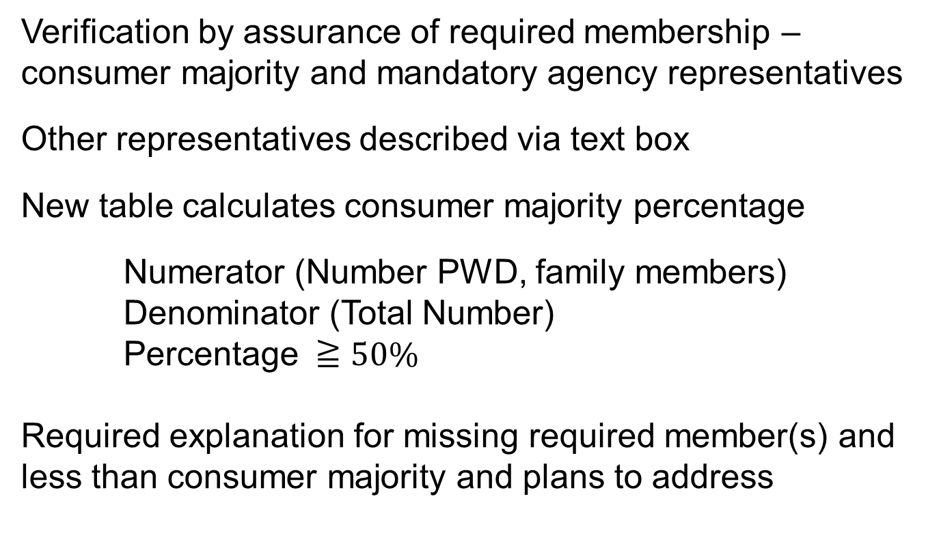
Screen 3: Advisory Council
Verification by assurance of required membership – consumer majority and mandatory agency representatives
Other representatives described via text box
New table calculates consumer majority percentage
Numerator (Number PWD, family members)
Denominator (Total Number)
Percentage $≧50\%$
Required explanation for missing required member(s) and less than consumer majority and plans to address

Slide 7
Screen 4: Actual Expenditures & Budgeted Allocations (required annual update)
Report Actual Expenditures for Closed-out Carryover Year (2018 State Plan: 10/15-12/17 Award)
All expenditures assigned to State Level Activities or State Leadership Activities or prorated between
State level must be at least 60% of 70% of total
State leadership no more than 40% or 30% of total
Transition at least 5% of state leadership
Similar to old SF 425 with AT Act required expenditure data categories added

Slide 8
Screen 4: Actual Expenditures & Budgeted Allocations (required annual update)
Report Actual & Planned Immediate Preceding Year Award Expenditures (2018 State Plan: 10/16-present)
All liquidated expenditures reported in same categories as closed out award (state level, state leadership, transition)
Same reporting obligated not yet liquidated amounts
Same reporting budgeted not yet obligated amounts
Again similar to old SF 425. AT Act always required tracking these expenditure data categories – now will be reported.

Slide 9
Screen 5: Activities Conducted
New table to identify which state level activities are conducted, who conducts them, where they are conducted and if a fee is charged --
Combines multiple duplicative sections from old State Plan
AT Act State Level Activities | Activity Conducted? | Who conducts? |  |  | Where conducted? |  |  | Fee Charged
 |  | State | Other | Both | Central | Regional | Both
State Financing-Financial Loan | Yes/No
State Financing-Other that Directly Provides AT | Yes/No
State Financing-Other that Creates Savings for AT | Yes/No
Reuse-Device Exchange | Yes/No
Reuse-Device Open Ended Loan or Reassignment | Yes/No
Device short-term loan | Yes/No
Device demonstration | Yes/No

Slide 10
Screen 5: Activities Conducted (cont.)
New table identifies activities where comparability or flexibility is claimed
Yes/No to list of State Level activities & sub-activities
Financial Loan
Other SFA Directly Provides AT
Other SFA Creates AT Savings
Device Exchange
Device Reassignment or Open-Ended Loan
Device Short-Term Loan
Device Demonstration
All no within State Level Activity will require selection of comparability or flexibility. Narrative description required for comparability selection

Slide 11
Multiple Activity Item: Conduct with Written Agreement/Financial Support
Reduced choices to major partners used
Banks/financial institution
Independent Living Center
Easter Seals
Disability/AT Organizations
Federal Entities/Agencies
State Entities/Agencies
Local/Community Entities
Private Entities
Other (text box to describe)
Reduced “collaboration and how conducted” to: Have written agreement, provide financial support or receive financial support

Slide 12
Screen 6: Financial Loan Program
How – with whom conducted table
Type of loans offered (guarantee, revolving, etc.) drop down choices
Interest rate policy (highest-lowest percentage boxes)
Loan amount policy (highest-lowest number boxes)
Describe activity (text box)
Specific URL for financial loan program (text box)

Slide 13
Screen 7: Other SFA Directly Provide AT
How – with whom conducted table
Type of Other SFA provided (Telecommunications EDP, Last Resort, etc.) drop down choices
Describe activity (text box)
Specific URL for other SFA activity (text box)

Slide 14
Screen 8: Other SFA Creates AT Savings
How – with whom conducted table
Type of Other SFA provided (Cooperative Buying, AT Leasing, AT Fabrication, etc.) drop down choices
Describe activity (text box)
Specific URL for other SFA activity (text box)

Slide 15
Screen 9: Device Exchange Screen 10: Device Refurbish – Reassignment & Open-ended Loan
How – with whom conducted table
How Exchange Works (transaction consumer to consumer or State AT Program is involved) drop down choices select one
How Refurbish Works (ownership reassigned or loaned) drop down choices can select multiple
Describe activity (text box)
Specific URL for reuse activities (text box)

Slide 16
Screen 11: Device Short-term Loan Screen 12: Device Demonstration
How – with whom conducted table
How majority of loans are made (shipped or in-person) drop down choices select one
Describe activity (text box)
Specific URL for device loan activity, same for demonstration (text box)

Slide 17
Screen 13: Training Screen 14: Technical Assistance
How – with whom conducted table
Training – Short description of at least 1 no more than 3 planned activities: ICT training description required, transition training description optional and statewide conference optional (text boxes)
Technical Assistance – Short description of at least 1 no more than 2 planned activities (text boxes)
Specific URL only for training activity (text box)

Slide 18
Screen 15: Public Awareness Screen 16: Information & Assistance Screen 17: Assurances
How – with whom conducted table
Public Awareness – Short description of at least 1 no more than 2 planned activities (text boxes)
Information and Assistance – Describe activity (text box)
Assurances – affirm and certify, performance measure data in APR referenced

Slide 19
Updates to next APR (FY2017-2019)
Revisions for next 3 year APR will be minor
NO new data elements that need to be collected from beginning of fiscal year.
Add tag for category of anecdotes submitted (Education, Employment, Community Living)
Delete low vs preferred interest categories in financial loan type data element (actual interest data already reported in another data element)

Slide 20
Updates to next APR (cont.)
Combined reassignment & open-ended loan
New required description of high impact ICT accessibility training
Eliminated numeric data in Public Awareness as estimates were wildly inconsistent – Replace with descriptive data
Describe at least one but no more than two innovative or high impact public awareness activities

Slide 21
Next Steps
OMB Approval - updated State Plan and APR
Fiscal office training?
CATADA Web Portal
FY16 Data is posted
Can use CATADA to generate shell Annual Report for your state
NATADS
Updates to align with new OMB approved instruments

Slide 22
Questions/Contact
CATADA (data reporting)– Diane Golden
diane.golden@ataporg.org
CATADA (web portal) – Frank Smith
frank.smith@umb.edu
CATADA/NATADS – Vance Dhooge
vance.dhooge@ataporg.org

