Slide 1
One Big (Good) Thing
Addendum
CNMI, Delaware, Florida,Georgia and Hawaii

Slide 2
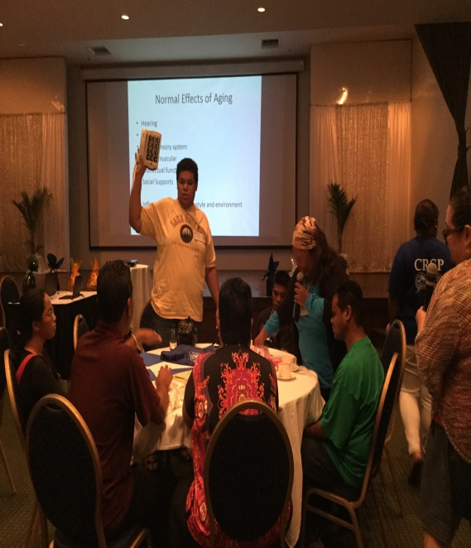
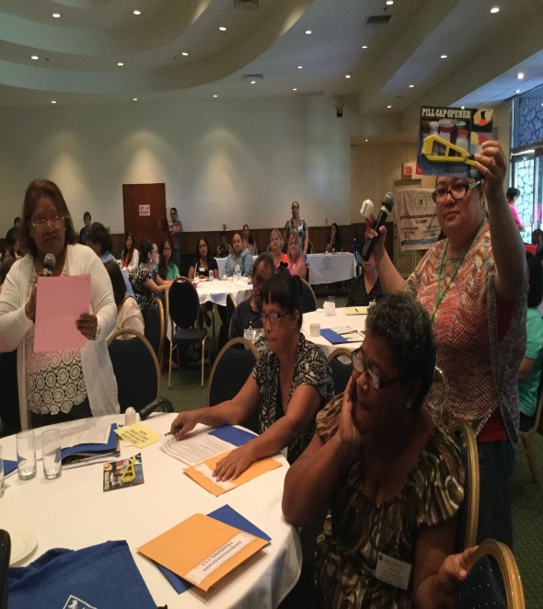
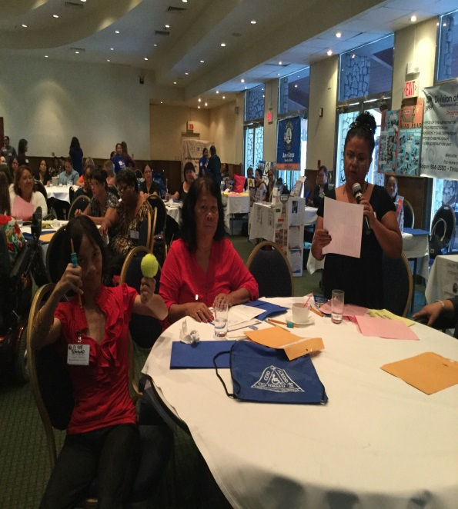
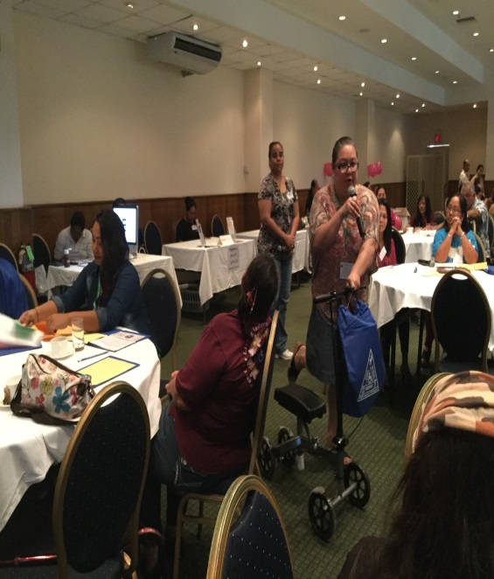
CNMI Assistive Technology Program
The CNMI Assistive Technology conducted training to (70) participants of individuals with disabilities, family members, and caregivers during the Commonwealth Respite Service Program (CRSP) Workshop at Fiesta Resort Hotel.
AT program staff provided hands-on training on a variety of low tech and high tech assistive technology for daily living needs to participants so that they have the opportunity identify, demonstrate, and perform the features and function of the assistive technology.

Slide 3
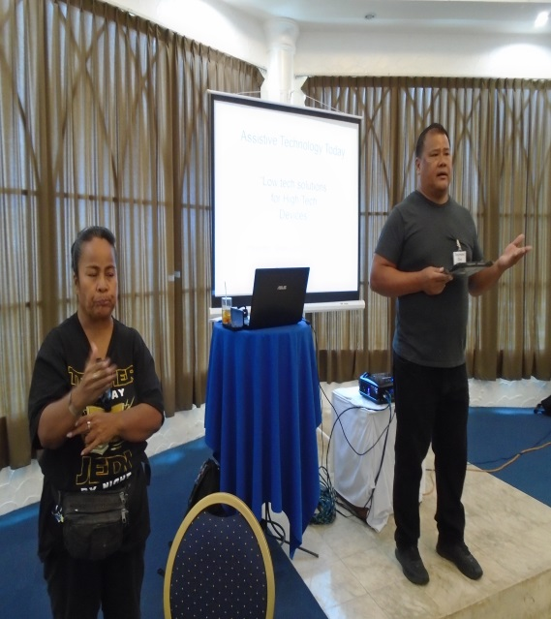
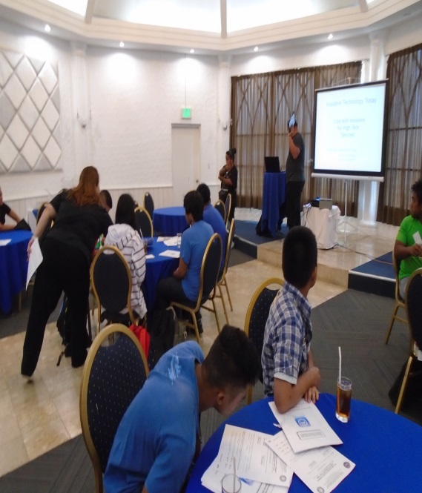
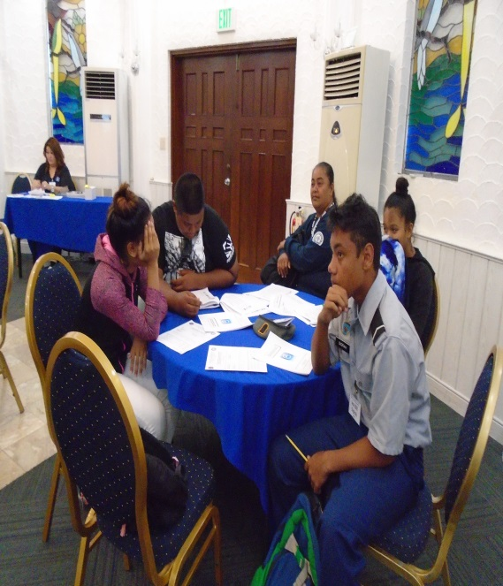
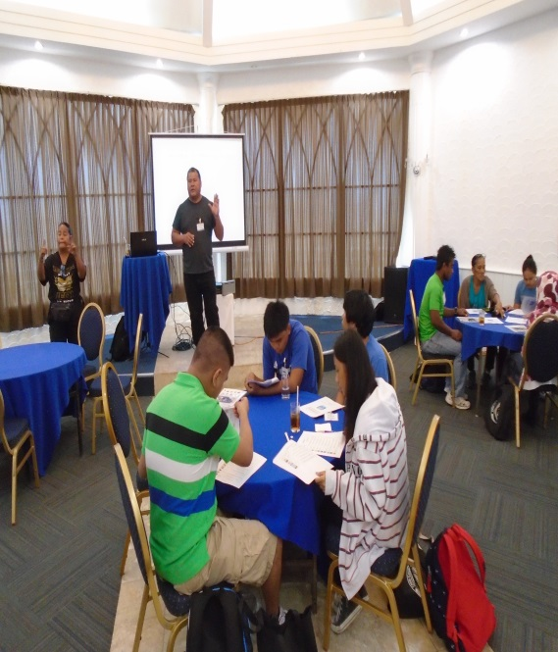
CNMI Assistive Technology Program
The CNMI Assistive Technology conducted training on apps to (46) students with disabilities and special education teachers during the Transition Mini Conference held at Kanoa Resort Hotel.
AT program staff provided training on Assistive Technology Today on apps for IPad, IPhone, and Android. The training was conducted to students with disabilities to increase their knowledge with apps and it’s features. Students will be able to use apps as an educational tool or employment.

Slide 4
Delaware
Education Technology Task Force
(Senate Concurrent Resolution #22)

Slide 5
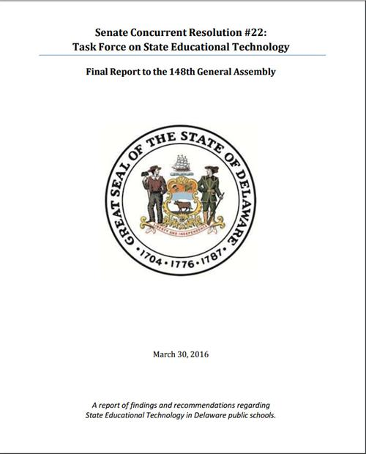
Delaware Education Technology Task Force Three subcommittees: infrastructure, teaching & learning, and assistive technology
Recommendations
Create and adopt uniform AT-specific guidance for early intervention and PreK-12.
Develop and promulgate guidance specifying expectations regarding procurement of accessible educational technology and the processes for ensuring compatibility among infrastructure, hardware and software so that students with disabilities have contemporaneous access to the same learning opportunities as their peers without disabilities.
Establish a centralized fund for acquisition of AT.
By the 2019-20 school year, the majority of instructional resources are digital, and are fully accessible for all students, including those who use AT to access their materials.
By 2019-20 school year, the majority of instructional resources are digital, and are fully accessible for all students, including those who use AT to access their materials.
All educators will have sufficient knowledge, skills and dispositions—as well as access to consistent and predictable acquisition mechanisms—to ensure that students with disabilities have access to the AT needed for engagement, learning and skill demonstration:
Create companion documents to IEPs/IFSPs that prompt teams to engage in AT consideration and documentation consistent with the guidance documents;
Deliver comprehensive PD to educators; and
Establish competencies for those serving in AT leadership roles.
…to ensure that all Delaware students have access to modern and effective educational technologies that enhance learning and promote college and career readiness.

Slide 6
FAAST Regional ReUse Centers FAAST has partnered with Center’s for Independent Living located in Broward, Fort Myers, Miami, Pensacola and Tampa to provide Regional Reuse Centers throughout Florida.
Our ReUse Centers provide the following services:
Device reutilization, repair and refurbishment: Consumers may bring in their devices to be repaired and returned to them, or may donate devices to be refurbished to be repaired as needed and then offered for sale, loan, or given away to other consumers in need. Oct.-Feb 2017- 165 devices saving $58,646
Open-ended device loans: - Open ended loans are typically long term with the device placed with a consumer on a permanent basis but done via loan rather than ownership transferring to the client. Consumers can keep a borrowed device for as long as required to meet a particular need. Oct.-Feb. 2017- 293 devices saving $48,228
Device exchange activities: Devices are posted on AT list through the FAAST web site. Consumers may use the contact information provided in the listing to obtain the device. Oct.- Feb. 2017- 100 devices exchanged saving $37,756

Slide 7
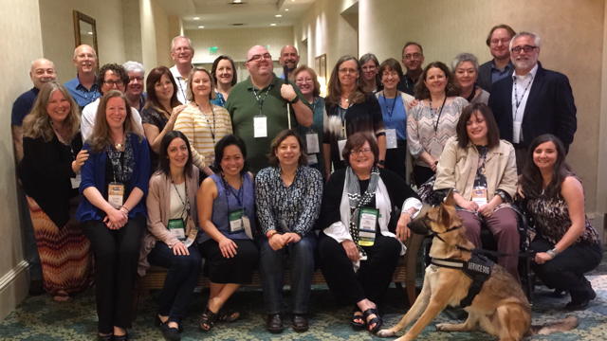
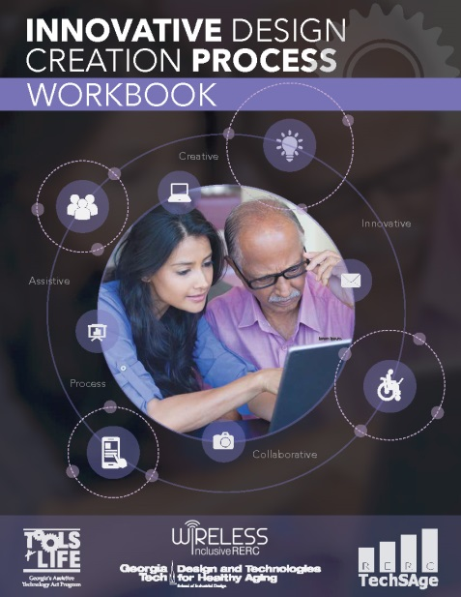
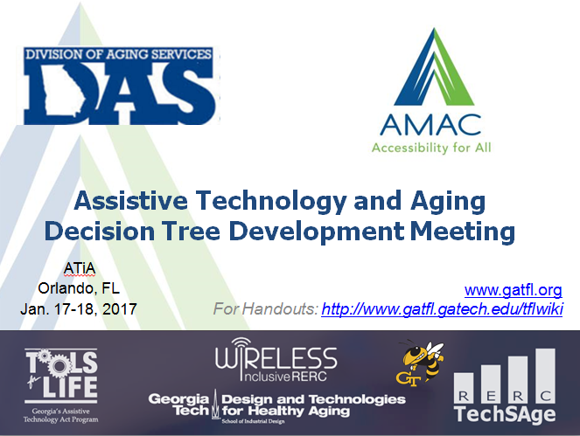
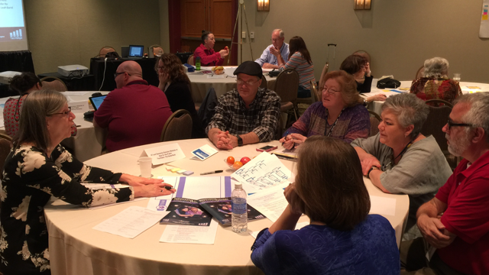
Georgia – Tools for Life

Slide 8
Assistive Technology Decision Tree/Algorithm Tool(s)
Grew from observing options counselors using Determination of Need – Revised (DON-R) Tool.
Significant discrepancies
Data analysis confirmed
Development of a Tool that would Guide, Learn, Grow and provide direction.
Woven into Harmony
Developing Stand Alone Tool
Submitted DRRP Proposal to grow this important work – fingers crossed!
Transformational work with many of You to help our Partners – Aging, Dementia, Mental Health & Education. (Hosted 3 national Workshops and will host more – including at ATiA 2018!) THANK YOU, AT Act Partners!
Launched Initiative to have AT Labs in 4 Aging and Disability Resource Centers (ADRC/AAAs). Just received funding for 7 more.
Launched AT Labs at state, Regional and National Aging & AT Conferences (n4a, Healthy Communities in Georgia, HCBS Conference in DC, National Dementia Conference in Atlanta in June) THANK YOU, WATAP, PIAT, and FAAST!
Technology & Aging Summit – November 2018! (AT and Aging HackFest – last weekend)

Slide 9
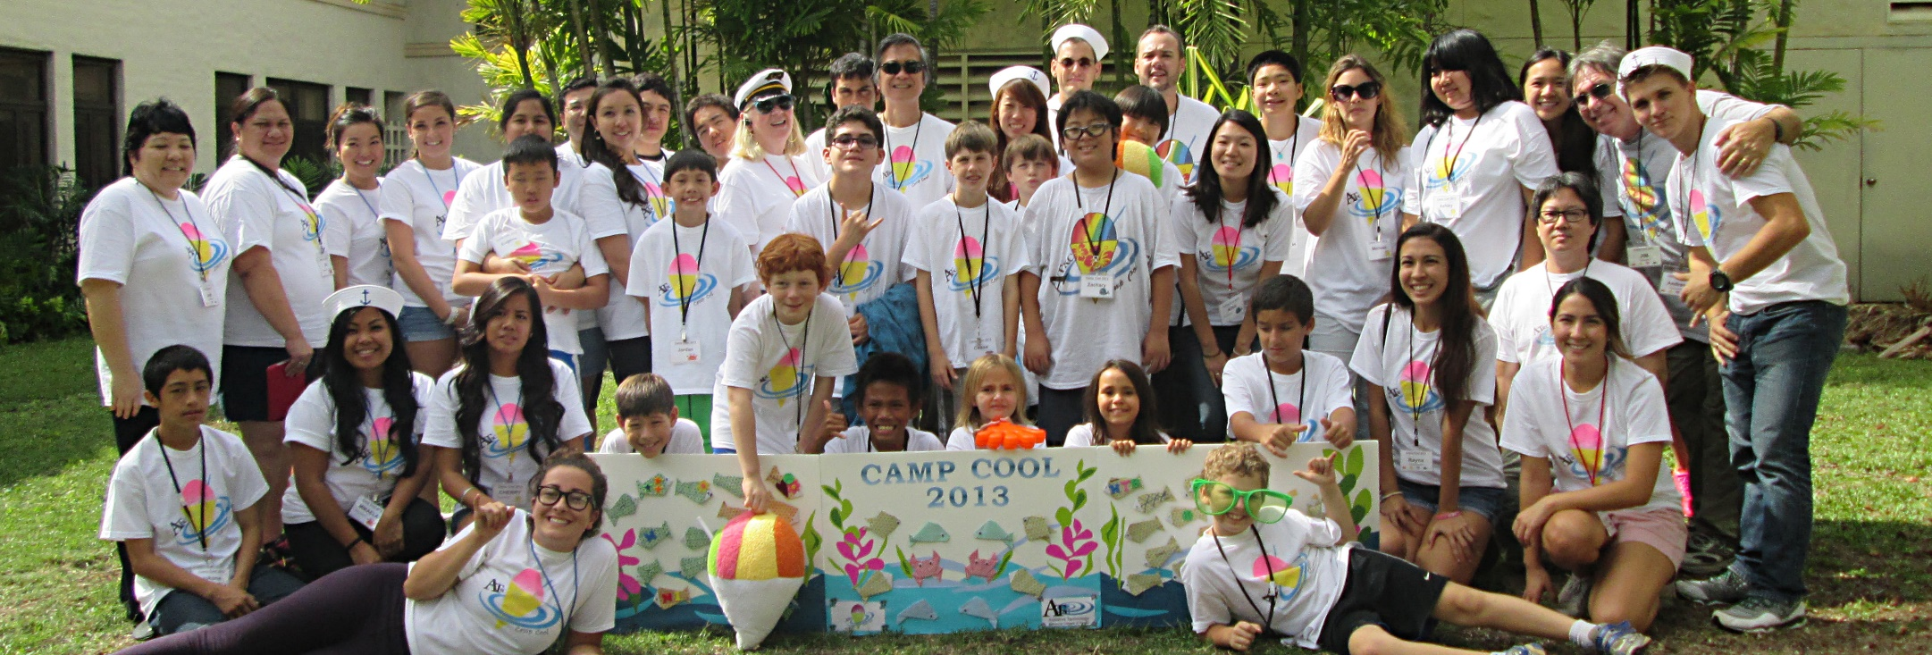
CAMP COOL-An interactive computer exploration experience for children ages 8-15. Children with disabilities and their sibling or best friend come together for two consecutive Saturdays. Campers learn website development, videography and digital photography and use computer and app based applications as the learn, explore and play with AT.
The goal of the program is to introduce children with disabilities to a variety of technology concepts increase their knowledge, skills and self confidence.
Visit the ATRC website for more information on CAMP COOL – WWW.ATRC.ORG

Slide 10
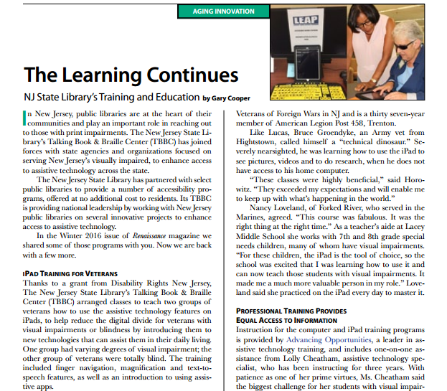
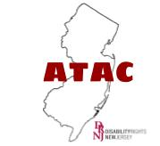
With ATAC Funding New Jersey State Library’s Talking Books and Braille Center provided training to Veterans on uses of everyday technology (smartphones / tablets) to increase independence.
New Jersey Foundation for Aging – Renaissance Magazine; Vol 24; Number 1; Spring 2017
drnj.org/ATAC @ATACNJ

