Slide 1
Care and Feeding of Subcontractors
2017 Leadership Symposium
March 27, 2017
Linda Jaco – Oklahoma Able TECH
Kim Moccia – Minnesota STAR Program
Marty Exline – AT3 Center (moderator)

Slide 2
Oklahoma ABLE Tech
A Collaboration with Oklahoma Partners to Offer a Statewide AT Demonstration and Short-term Loan Program

Slide 3
Key Players
Organizations that provide direct AT-related services to Oklahomans with disabilities (i.e. hearing, vision, speech, mobility, daily living, etc.)
Oklahoma ABLE Tech

Slide 4
Key Players (con’t)
Hearing Loss Association
Total Source for Hearing Loss and Access
OSU Department of Communication Sciences and Disorders
OU John W Keys Speech and Hearing Clinic
Pathways Therapy Center
The Children’s Center
NewView (OKC and Tulsa)
Handicapped Vehicle Services
Newby-Vance Mobility
United Access Mobility

Slide 5
Background
Memorandum of Agreement (MOA) Developed in 2005
Need to provide an affordable, comprehensive, statewide AT demonstration and short-term loan program to Oklahomans with disabilities
ABLE Tech reached out to a variety of organizations serving individuals with disabilities with the offer of AT devices that would expand and enhance service delivery options in exchange for AT demonstration and short-term loan data – per the AT Act

Slide 6
MOA Developed
Partners responsible for:
Primary contact person within each organization
Space to house AT
Acknowledgement of partnership on marketing materials
Development of operational procedures, that at a minimum, identify:
    Maximum AT loan term to not exceed 42 days
    Borrowers are responsible for returning item in same condition, excluding normal wear and tear
    Borrowers are responsible for the cost of repair – or if not returned- the replacement of a device
Demo and short-term loan reports to ABLE Tech by the 5th of each month – utilizing NATADS web-based system
Routine maintenance of all AT equipment

Slide 7
MOA Developed (con’t)
Participation in an annual AT inventory report
Attendance at 2 annual trainings
Attendance at 1 AT webinar hosted by ABLE Tech
Submission of 4 annual AT success stories – utilizing the ABLE Tech Success Story/Photo Release Form
Completion of an AT Demonstration Survey reported in the NATADS web-based system
Completion of an AT Short-term Loan Survey completed by borrower and returned with device and reported in NATADS web-based system

Slide 8
MOA Developed (con’t)
ABLE Tech responsible for:
Purchasing and bar coding of all equipment – ABLE Tech maintains ownership of all equipment
Conduct an annual inventory with each partner – ABLE Tech determines and removes any obsolete or underutilized equipment
Based on available funding, ABLE Tech purchases and bar codes new AT for each partner on an annual basis
Report format for success stories with release forms
Provides both the AT demo and short-term loan surveys

Slide 9
MOA Developed (con’t)
ABLE Tech responsible for:
Quarterly reports to ABLE Tech Advisory Council / Annual reports to ACL
Monthly newsletter
Development of AT webinar series
Training at both mandated partner meetings

Slide 10
Successful Outcomes
FFY 16 Data:
ABLE Tech and its partners provided 4,949 AT device demonstrations to 10,133 Oklahomans across OK
ABLE Tech and its partners provided 2,204 AT short-term loans to Oklahomans across OK

Slide 11
Questions?
Contact Information:
Linda Jaco
Oklahoma ABLE Tech
Phone: 405.744.9864
Email: linda.jaco@okstate.edu

Slide 12
Minnesota STAR Program
Lessons Learned: Working with Subcontractors

Slide 13
Contract Evolution
- Monitoring and Measuring Success
2005 – 2011 – Partner Proposed
2010 Peer Review Recommendation
2011 – 2015 – Performance Based
2016 – Present – Master Contract

Slide 14
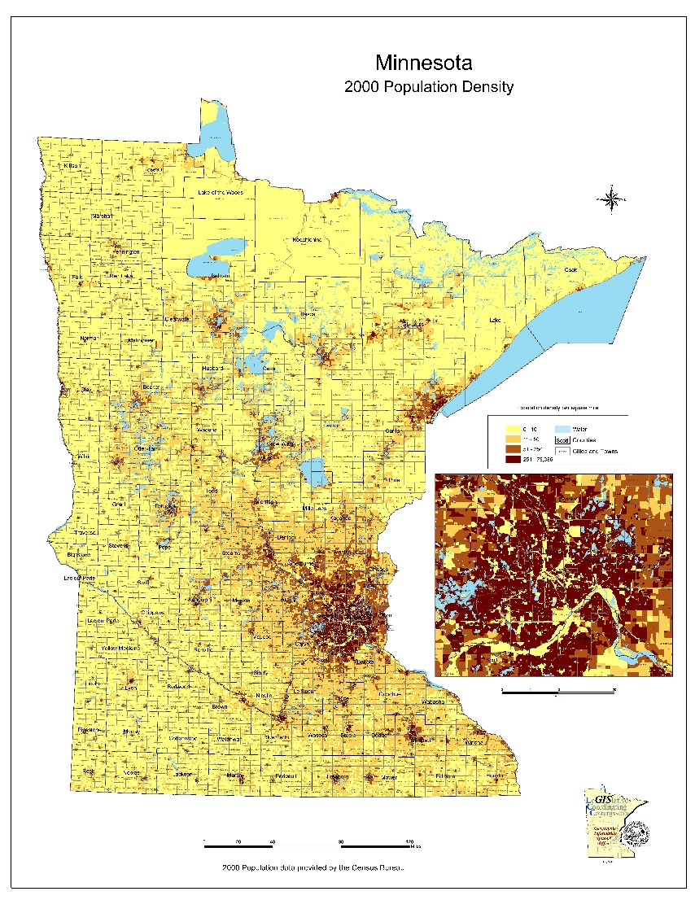
Minnesota by the Numbers
87 Counties
73% (3.9 million) live in an urban area
11% (609,000) live in large towns
8 % (434,000) live in a rural area
7% (390,000) live in small towns
10.5% (593,700) – residents have one or more disabilities
Older residents more common in non-urban areas (44% rural residents are over the age of 50)
Notes:
Contracts influenced by state/territory demographics
Urban/Rural statistics from:
From Greater Minnesota: Refined & Revisited (2017 Report – MN Demographic Center)
Definition:
Urban – population over 50,000
Large town – population between 10,000 and 49,999
Small town – population between 2,500 to 9,999
Rural – population under 2,500
Disability statistic based on 2015 American Community Survey

Slide 15
Partner Proposed Contracts
  Request for Proposal (RFP)
      Based on modified version of state professional/technical contract templates
  Professional service activities requested:
      Purchase AT
      Conduct demonstrations and device loans
      Collect data (customer survey)
      Submit quarterly reports
  Respondent required to submit
      Brief summary of organization highlighting its AT services, accomplishments, and goals
      List AT the organization will make available for demonstration/loan
      Describe how partnering with STAR fits into organization’s overall goals
Notes:
Partners required to collect completed customer surveys and retain for 7 years, as required by state retention policy, and must furnish copies of completed surveys, if requested.
STAR has had one instance where it investigated a specific partner for performance concerns; having access to completed customer surveys helped during the investigation.

Slide 16
Partner Proposed Contracts (continued)
Respondent required to submit
    Number of consumers served
    Service/activity proposal
    Geographic service area
    Targeted populations
    Past and current AT collaborations
    Resume of key persons
    Budget narrative and line-item budget
    Acknowledgment that key persons will attend required training
    Provide required assurances (federal/state)

Slide 17
Partner Proposed Contracts (continued)
Review Process
    Review committee – 3 to 5 advisory council members
    105 Point Scale
      Plan of Action (40 points)
      Capacity/Capability (30 points)
      Agency Commitment (15 points)
      Budget (15 points)
      Discretionary – other considerations, uniqueness, innovation (5 points)
  Restrictions
      Funds may not supplant other funding sources
      Indirect costs and space rental not allowed
      Administrative costs not to exceed $300
Notes:
STAR still uses 105 point scale but categories/point allocations have changed.

Slide 18
Partner Proposed Contracts (continued)
Pros
  More subcontractors/partners
  Higher service numbers reported
Cons
  Informal paper-based data collection
    Partners were allowed to use their own system
  Took longer/more resources to compile data and enter into master Excel sheet
  Incomplete reporting (non-respondent or other)
  Low performance measures
  Lack of control over AT purchased by partner with contract dollars
Notes:
Unclear to what extent other factors, beyond the contract structure, influenced response to RFP
AT community providers have been dwindling due to staffing shortages and decreased resources.

Slide 19
Performance-Based Contracts
Proposals reviewed and contract awarded based, in part, on:
    Projection Forms
        Disability Type
        Domain (education, employment, community living)
    Population served
    Geographic region

Slide 20
Performance-Based Contracts
Other contract changes:
    Agree to use NATADS to submit quarterly data
    Agree to submit one anecdote per quarter
    No longer receive funding to purchase AT
    May submit formal AT request, if needed

Slide 21
Performance-Based Contracts
Initially paid:
  $55 per demonstration/short-term loan
    $70 (activities related to employment)
  $100 per open-ended loan
  Postage (varied per length and terms of contract)
  Travel expenses (varied per length and terms of contract)

Slide 22
Master Contracts
Why switch?
  Allow potential subcontractor more time to submit RFP (deadline is January 2020)
    Increase number of new partners
  Quick access to approved subcontractors
  Issue work orders, as needed
  Worth noting:
  Entering into a Master Contract does not guarantee the subcontractor will be issued a work order
  Subcontractors can submit new proposal to add other service activities

Slide 23
Master Contracts
Current reimbursement:
    $60 per demonstration/short-term loan
    $100 per open-ended loan
    Postage - will be reimbursed when the total cost for postage is over $20.00. $300 cap per quarter.
    Travel expenses – will reimburse when travel exceeds 50 miles round trip. $300 cap per quarter.
Notes:
Language from contract:
Reimbursement for travel incurred by the Contractor as a result of this contract will only be made when the total is over 50 miles round trip. Reimbursement will not exceed $300.00 quarterly during the term of the work order. Reimbursement rates for mileage will follow the IRS guidelines for reimbursement and will be adjusted if such rates change during the time of the work order. Requests for travel reimbursement must be submitted on a Postage and Travel Expense Report (Exhibit A) along with a Request for Funds form (Exhibit B) and appropriate receipts. Postage expenses will be reimbursed when the total cost for postage is over $20.00. Requests for reimbursement of postage expenses must be submitted on a Postage and Travel Expense Report (Exhibit A) along with Request for Funds form (Exhibit B) and appropriate receipts. Reimbursement will not exceed $300.00 for each quarter of a work order.

Slide 24
Working with State Agencies
Memorandum of Understanding with Department of Employment and Economic Development
    Vocational Rehabilitation Services
    State Services for the Blind
Agency Agreement with Department of Human Services
    Deaf and Hard of Hearing Services

Slide 25
Beyond Contracts
Finding Partners
Establishing Procedures
Training
Developing and Maintaining Relationships
Notes:
Finding partners: state register, social media, advisory council, newsletters, email list, word of mouth, asking other agencies/organizations to get the word out
Establishing procedures: important to be consistent, have written policies and procedures (review regularly and be willing to revise)

Slide 26
What Shape Are You?
Circle - 
Triangle - ▲
Square - ■
Squiggle - §
Partners are people
  Know your personality type
  Identify their personality type
  Remember positive partnerships embrace all shapes
Notes:
Free shape quiz: http://listening2leaders.com/shape-quiz-learn-colleagues/

Slide 27
Questions?
Contact
Kim Moccia
Department of Administration/STAR Program
651-201-2297
Kim.Moccia@state.mn.us
Notes:
Finding partners: state register, social media, advisory council, newsletters, email list, word of mouth, asking other agencies/organizations to get the word out
Establishing procedures: important to be consistent, have written policies and procedures (review regularly and be willing to revise)

Slide 28
Elements of Subcontracting Agreements
Description of services to be performed (deliverables); Population to be served; Geographic area to be served
Operational procedures
Budget & Payment structure
  Set amount with targets?
  Performance incentives?
    Maximum payment
  Can withhold payment if sub-par?

Slide 29
Elements of Subcontracting Agreements
Aptitude, Qualifications, Experience of Staff
Appropriate space
Data Reporting
Invoice Periods
Anecdotes / Success stories / Pictures
Marketing
Outreach
Mention of State AT program
Annual Inventory Report
Maintain Equipment

Slide 30
Elements of Subcontracting Agreements
Are you providing (Purchasing or loaning) equipment or dollars for equipment?
Removing obsolete or underutilized equipment?
Site Visits
Training
  1or 2 per year
  Webinars or calls for more narrowly focused
  Vendor visits
  Conferences

Slide 31
Beyond the Agreement
Recognitions
Other incentives
Partners are People

Slide 32
Questions?
Contact Information:
Marty Exline
AT3 Center
816-547-6577
E-mail: marty.exline@ataporg.org

